Slide 1
Workforce Development
Division of Vocational Rehabilitation
Veterans Affairs
Division of Blind Services
Orange County Public Schools - Project Compass

Slide 2
What is Workforce Development?
Workforce development focuses on individuals by providing them with training that increases their ability and makes them greater assets in the workforce.

Slide 3
Workforce Development with Goodwill
Employment Training and Work services program for individuals with disabilities fully funded by the Florida department of education’s division of Vocational Rehabilitation and other funders.

Slide 4
Services offered by workforce development team:
On-the-job training
VA extended evaluation
DBS work experience
Supported employment
Specialized placement
Self Advocacy
Pre-placement training

Slide 5
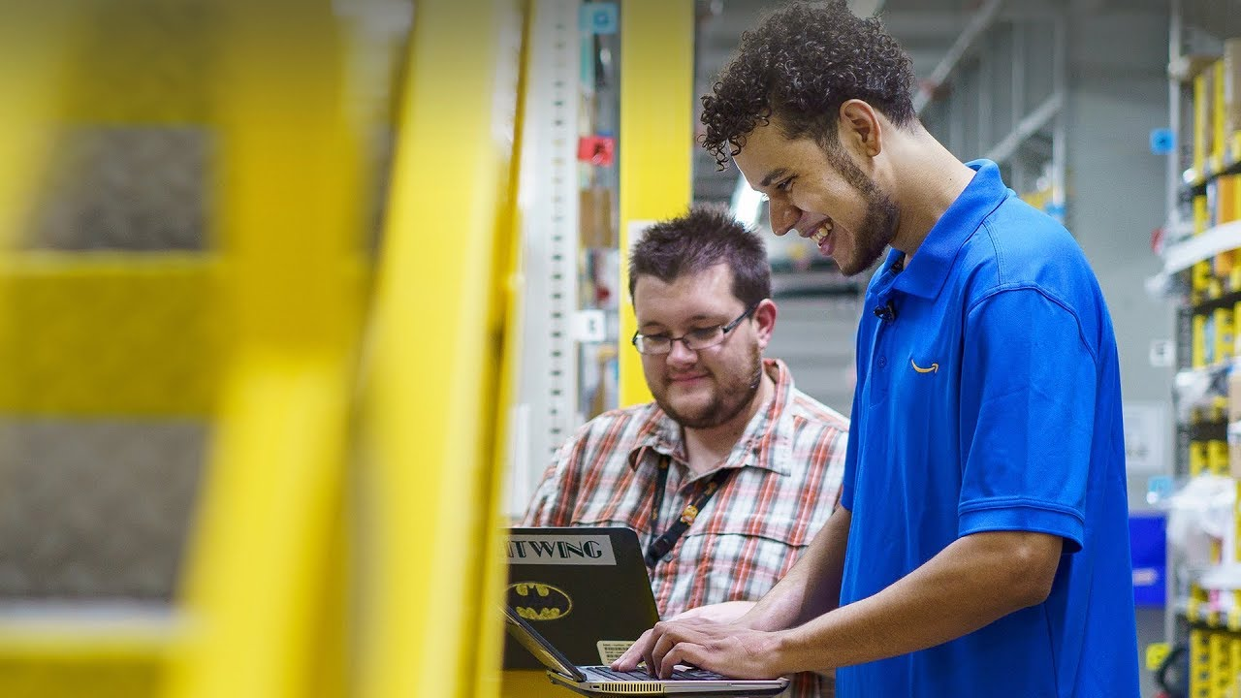
On-the-job training, VA extended evaluations, & DBS work experience
VR On-the-job training to prepare them for competitive employment.
VA Extended evaluations for veterans with service connected disabilities.
DBS Work experience for individuals who are legally blind or low vision.

Slide 6
Who are the participants for our training programs?
Individuals with disabilities referred to us by the division of vocational rehabilitation, veterans affairs, or division of blind services.

Slide 7
Meet our Vocational Specialists
These services are provided in six counties:
Volusia
Seminole
Lake
Brevard
Orange
Osceola.
Our Vocational Specialists:
Zachary Chandler (Volusia, Lake, Brevard, Seminole & Orange)
Allan Villavizar (Orange, Lake & Osceola)

Slide 8
Employment services: supported employment & specialized job placement
Specialized Job Placement: takes place when the individual begins working in an integrated, competitive employment for 90-days.
Supported Employment: ongoing support services for 180-days to maintain employment for individuals who require more intense training.

Slide 9
Who are the participants for employment services?
Individuals with disabilities have been referred to us by division of vocational rehabilitation have completed the on-the-job training program

Slide 10
OUR JOB PLACEMENT SPECIALISTS:
This service is provided by our qualified job placement specialists that cover all 6 counties
Job Placement Specialists:
QuSheida Fields
Christen Small

Slide 11
Thank you having us as your host!

Slide 12
Contacts Vocational Rehabilitation Link: http://www.rehabworks.org/index.shtml Veteran Affairs Link: Division of Blind Services Link: Goodwill Contact Information: CARLA COX – director of Strategic Development ccox@goodwillcfl.org cell: 689-217-4589 office: 407-235-1560

