Slide 1
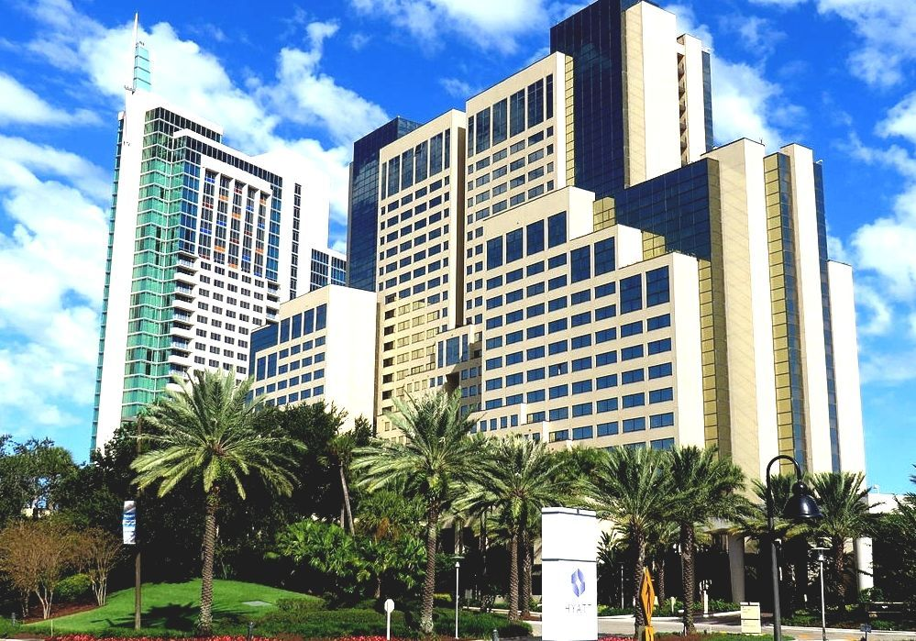
Accentuating the “I” in IEPs and IPEs

Slide 2
Hands On @Hyatt Hospitality training Program Providing WBLE’s since 1998

Slide 3
Program Description
State-Funded Alternative Training Program to prepare persons with disabilities for work in the Hospitality Industry
Started June 21,1998 at the
Hyatt Regency Westshore – Tampa, FL
Made possible through a unique partnership between Hyatt Hotels and Resorts,
Hands On Educational Services, Inc.
FL Division of Vocational Rehabilitation,
FL Division of Blind Services and
School District Transition Teams

Slide 4
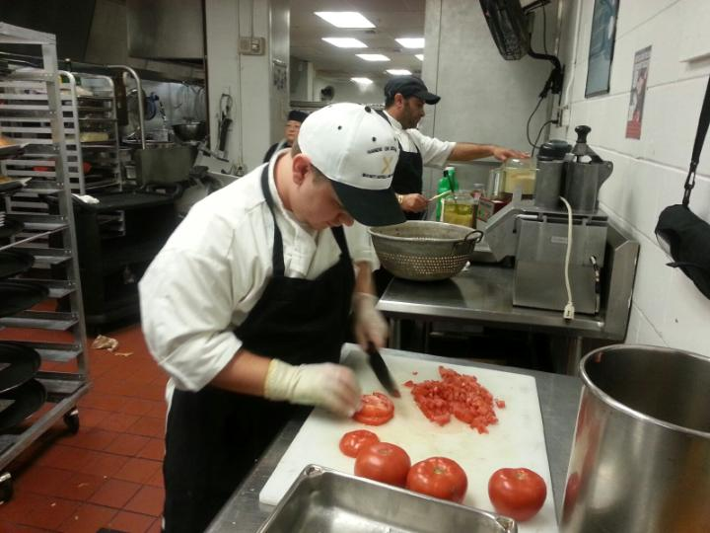
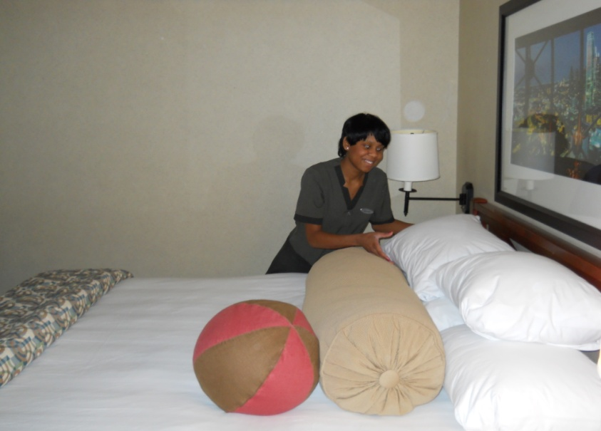
Training Departments
Culinary*
Housekeeping
Laundry
Storeroom Receiving
Engineering
Cafeteria Attendant
PBX Operator
* Denotes area where the majority of the students choose to train

Slide 5
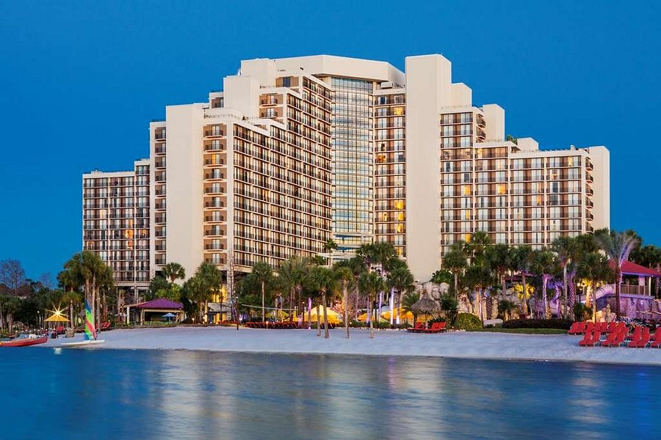
Current Hyatt Properties In Florida
Grand Hyatt Tampa Bay
Hyatt Regency Grand Cypress
Hyatt Regency Orlando Airport
Hyatt Regency Orlando
Hyatt Regency Miami
Hyatt Regency Sarasota
Hyatt Regency
Clearwater Beach
Hyatt Regency Jacksonville
Hyatt Regency Coconut Point
Hyatt Regency Coral Gables

Slide 6
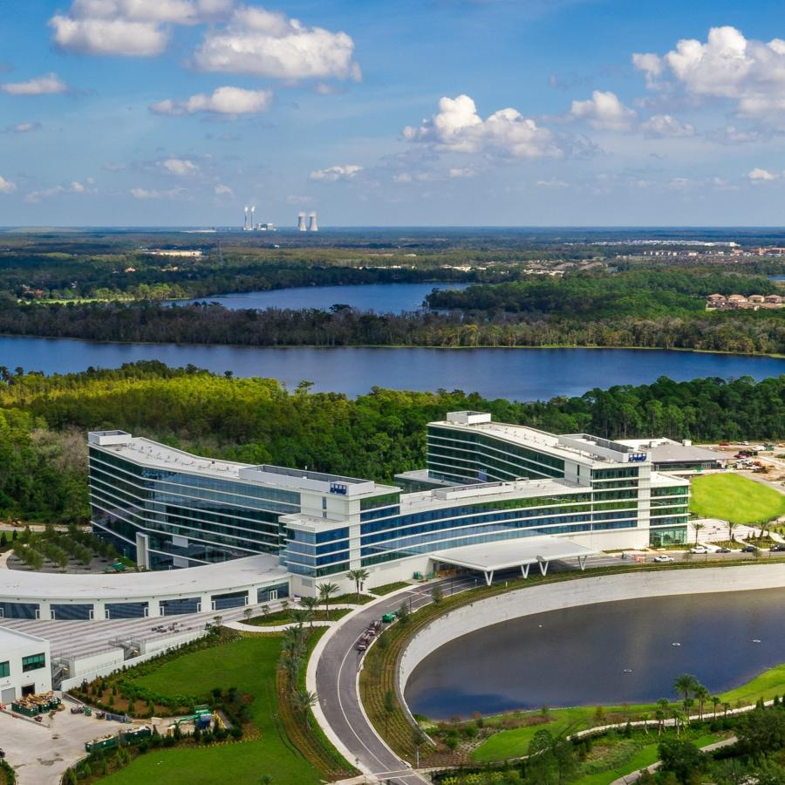
Growing capacity in Orlando
Hyatt Regency Orlando Convention Center
Hyatt Regency Grand Cypress Lake Buena Vista
Hyatt Regency Orlando International Airport
Hyatt Place Orlando International Airport
Hyatt Lakehouse - KPMG

Slide 7
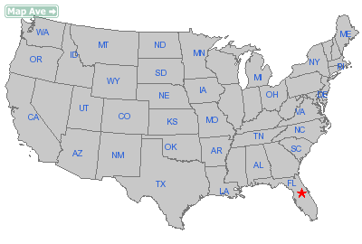
Currently partnering with 36 Hyatt Hotels and 15 State Vr Agencies across the US

Slide 8
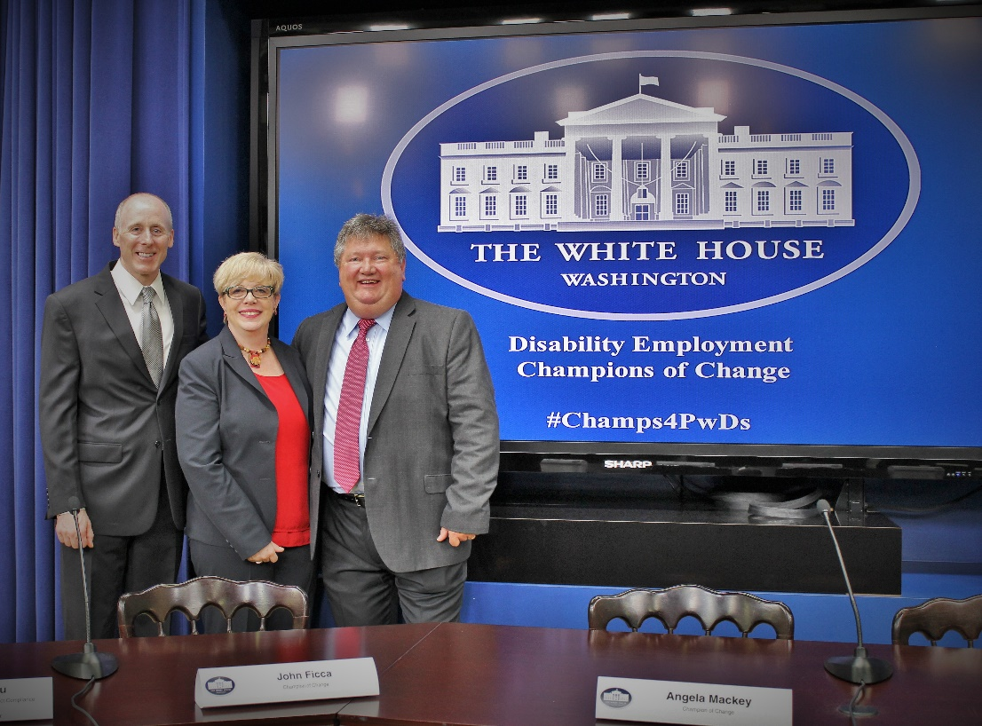
Employment Outcomes
>5000 graduates have obtained employment
Hyatt has hired over 950 graduates
Opportunities for graduates in Hotels, Restaurants, Hospitals and Grocery Stores
Oct 2014 – Recognized as one of the top 10 Training and Employment Programs, for PWDs, by the White House Champions of Change Program
Notes:
Background Check: No felonies in the last 7 years (from time the case was CLOSED, not from when charged). No Misdemeanor charges related to theft, violence, or sex related crimes.

Slide 9
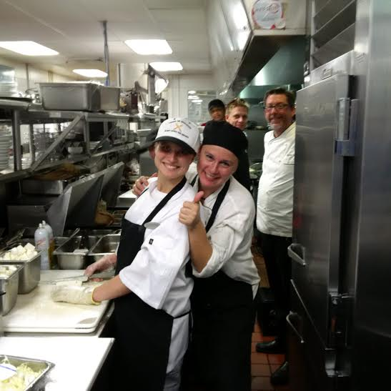
Applicant qualifications
Must be 18 years of age (some exceptions apply)
Must have documented disABILITY
Be able to perform functions of job
Background check completed for felonies or misdemeanors within past 7 years
A High School Diploma or GED is NOT required (because they are not required by the industry)
Notes:
Background Check: No felonies in the last 7 years (from time the case was CLOSED, not from when charged). No Misdemeanor charges related to theft, violence, or sex related crimes.

Slide 10
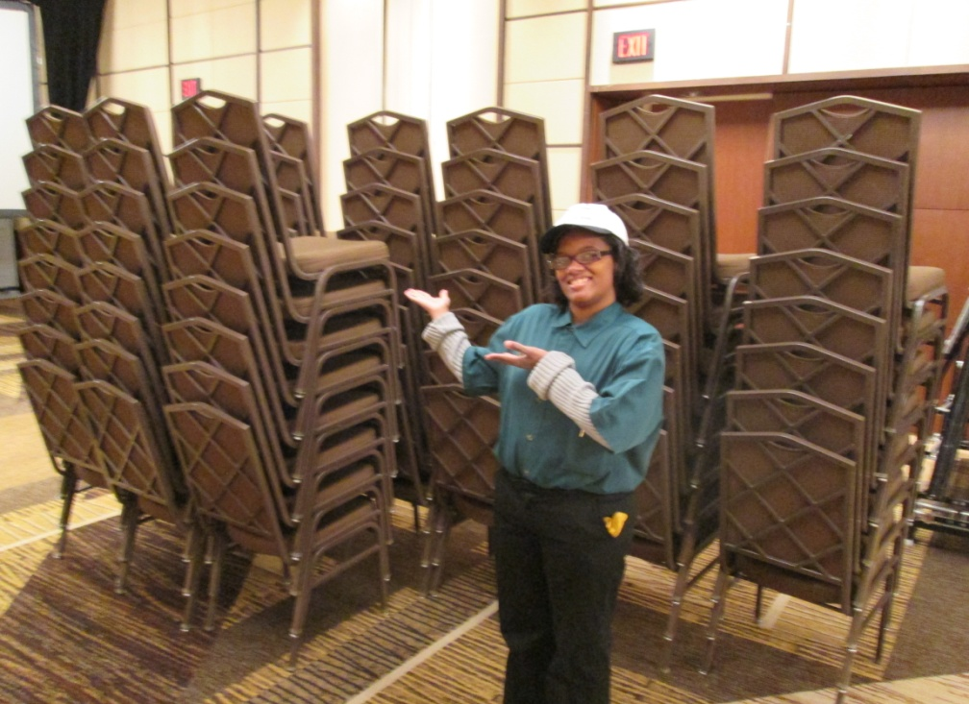
Features of Program
80-Hour Paid Internship over 2-8 weeks
Trainees are paid employees of Hyatt
Can list Hyatt as employment reference
Receive Certificates of Completion
Program includes uniforms, meals, etc.
Train with best professionals in industry
Notes:
Background Check: No felonies in the last 7 years (from time the case was CLOSED, not from when charged). No Misdemeanor charges related to theft, violence, or sex related crimes.

Slide 11
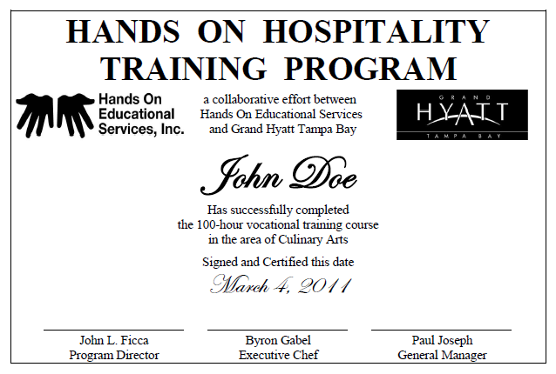
Certificate Example
Notes:
Background Check: No felonies in the last 7 years (from time the case was CLOSED, not from when charged). No Misdemeanor charges related to theft, violence, or sex related crimes.

Slide 12
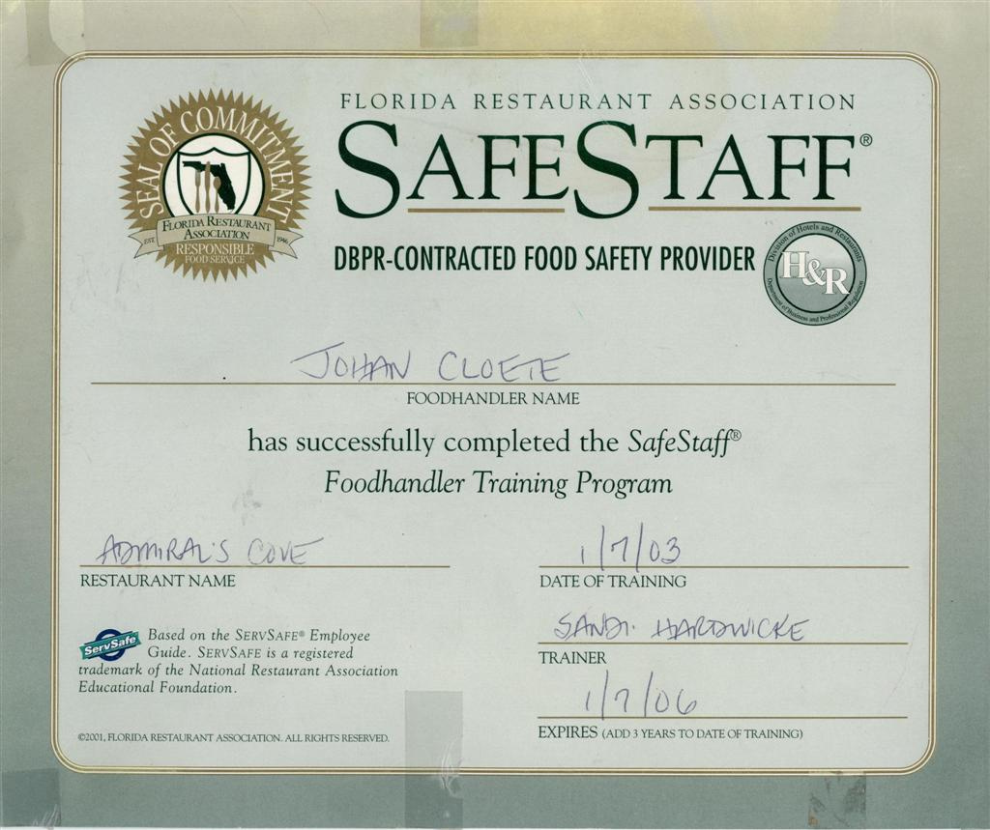
FL Restaurant Assn Food Handler’s Certification
John Doe
Notes:
Background Check: No felonies in the last 7 years (from time the case was CLOSED, not from when charged). No Misdemeanor charges related to theft, violence, or sex related crimes.

Slide 13
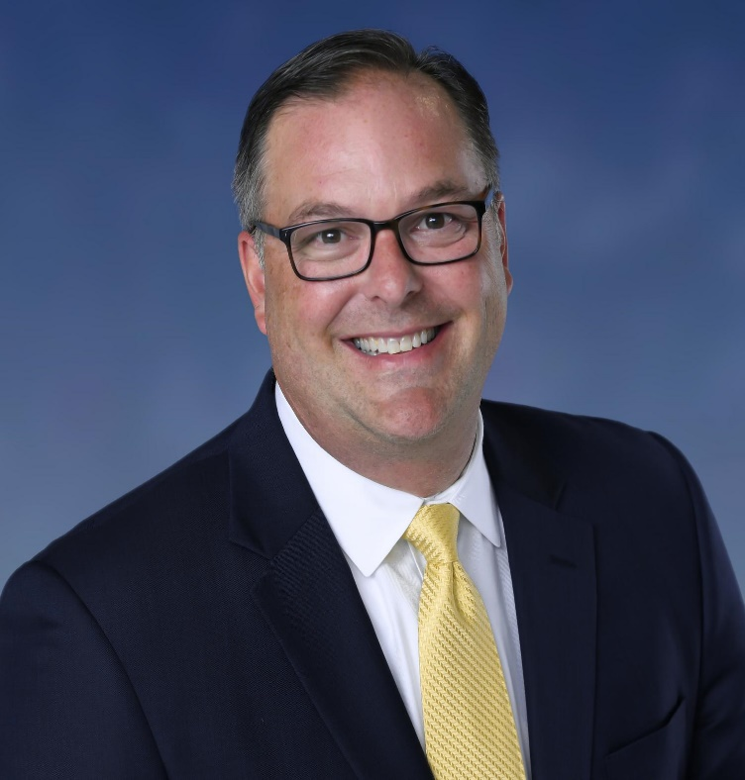
Mark Havard Area Director of Human Resources Hyatt Regency Orlando
“I have been fortunate to be partnering with Hands On Education for over 20 years at 3 different Hyatt properties. The hospitality learning opportunities for the Hands On trainees is extremely impactful. Our team embraces the trainees, focuses on their strengths and abilities, and provides them with rewarding experiences to grow their skills. It is unbelievable to see the growth in self-confidence of the trainees from day 1, through the completion of the program.”

Slide 14
WIOA Section 418 –TRAINING AND SERVICES FOR EMPLOYERS (2015)
(2) working with employers to
provide opportunities for work-based learning experiences (including internships, short-term employment, apprenticeships, and fellowships), and opportunities for pre-employment transition services;
recruit qualified applicants who are individuals with disabilities;
train employees who are individuals with disabilities
*Aligns perfectly with Hyatt’s Purpose and new RiseHY Initiative to hire 10K Opportunity Youth by 2025

Slide 15
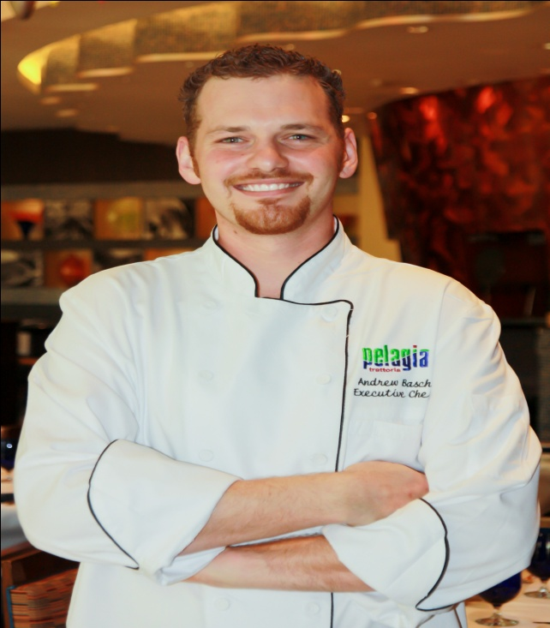
Hands On success Story
Andrew graduated Hands On @Hyatt in 2003
ESE Student w/ Special Diploma
Hired by Grand Hyatt Tampa Bay
2005 – left to help open a new local restaurant
2007 – landed at Renaissance Hotel (by Marriott)
2011 – Promoted to Exec Chef, Base Salary of 70K +
Full Benefits Package

Slide 16
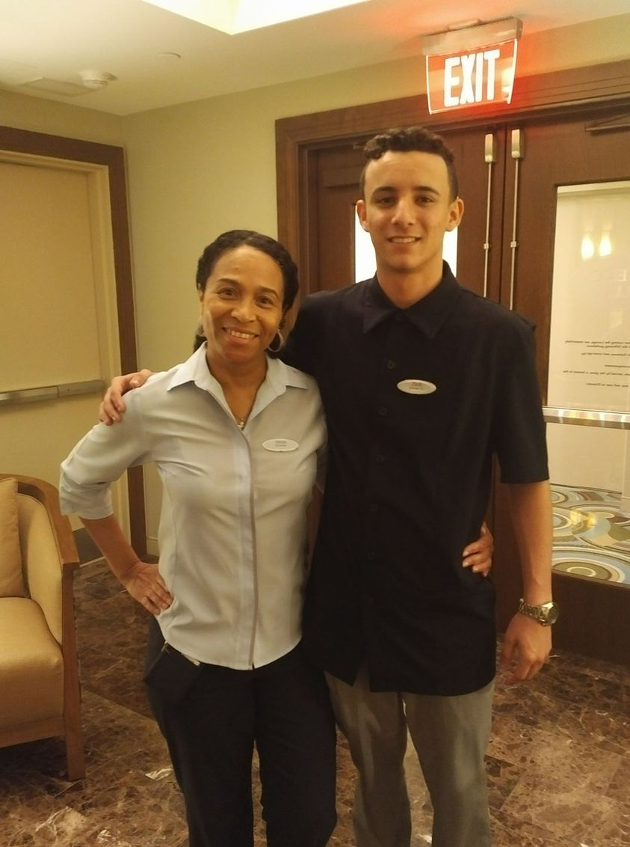
Hands On success Stories Cesar and Zack

Slide 17
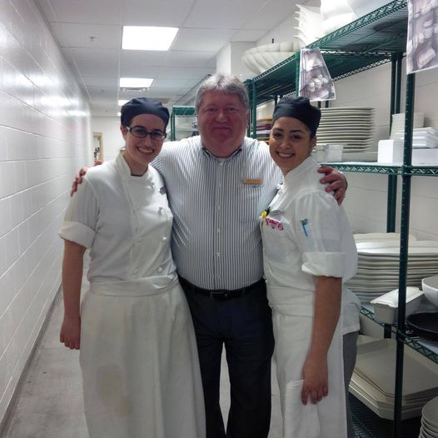
Hands On success Story Rachel The Student becomes the teacher
Rachel graduated Hands On @Hyatt in 2005
ESE Student from Orlando
Obtained cook position at Rosen Hotel
Applied for new position at The Peabody
2013 - Hyatt purchased The Peabody
2014 – Hands On @ Hyatt Regency Orlando

Slide 18
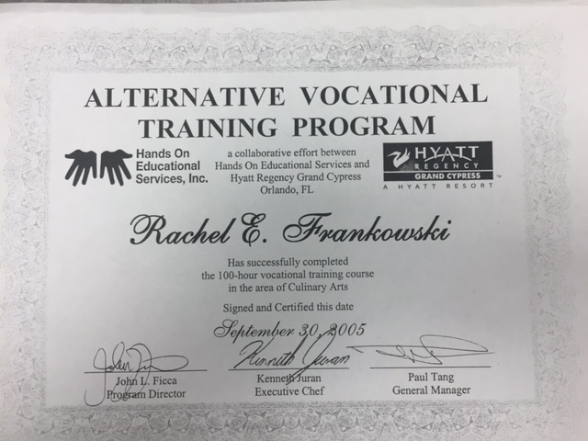

Slide 19
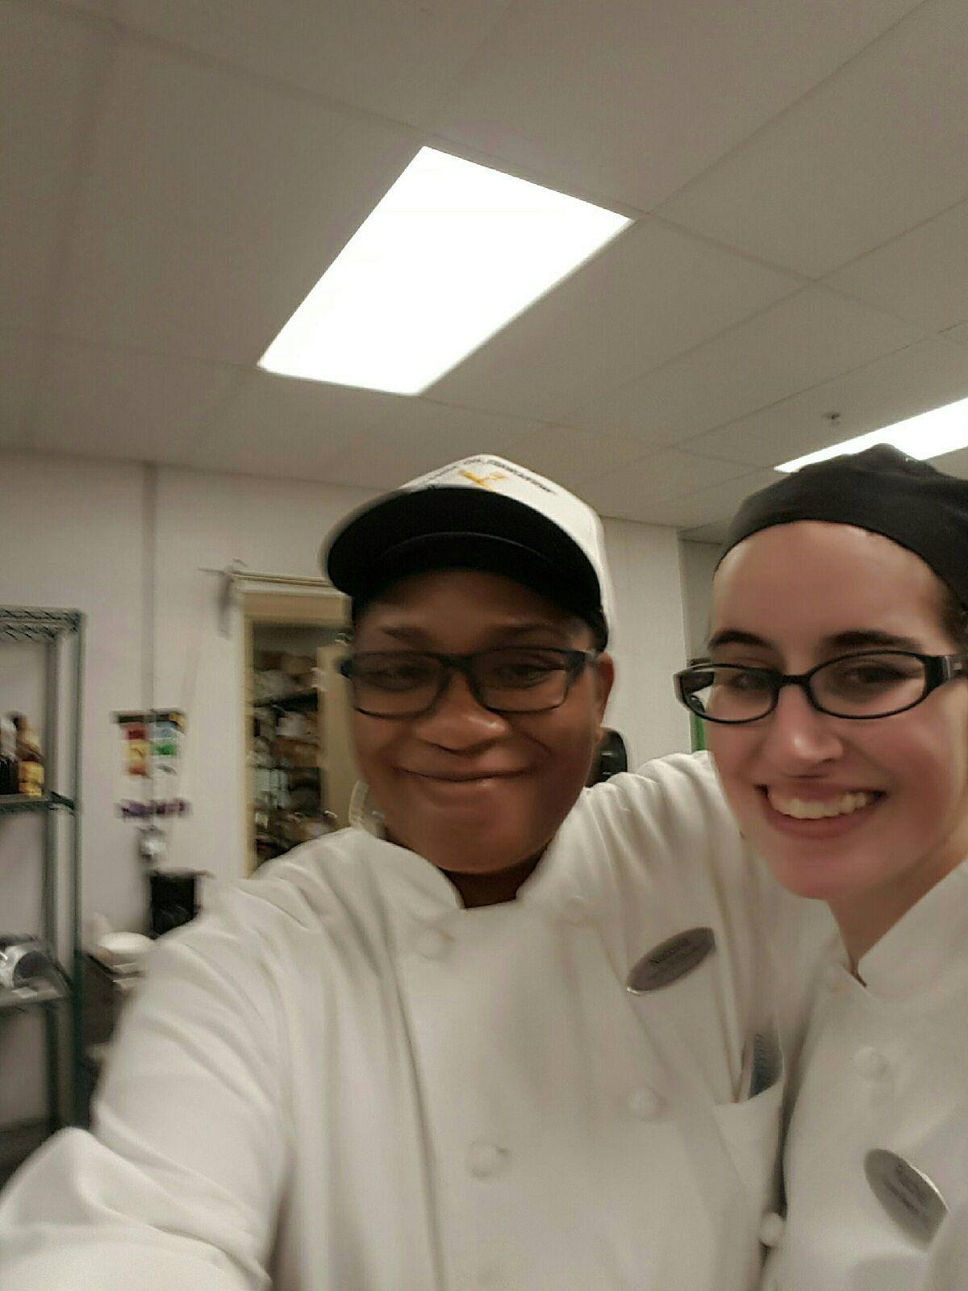
Hands On success Story Rachel The Student becomes the teacher

Slide 20
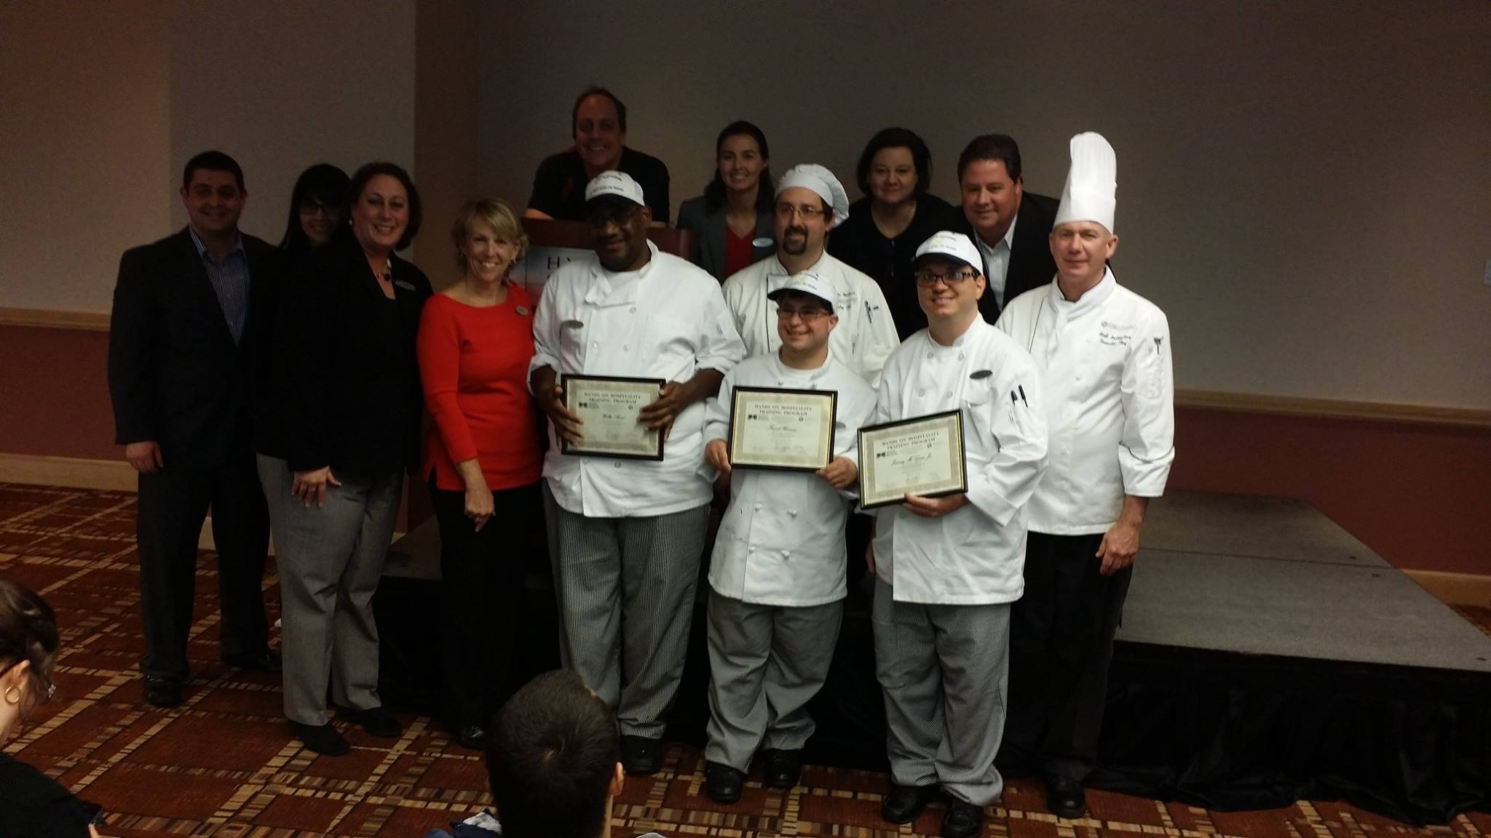
Hands On success Story Jimmy Graduated 2014 Hyatt Regency Jacksonville

Slide 21
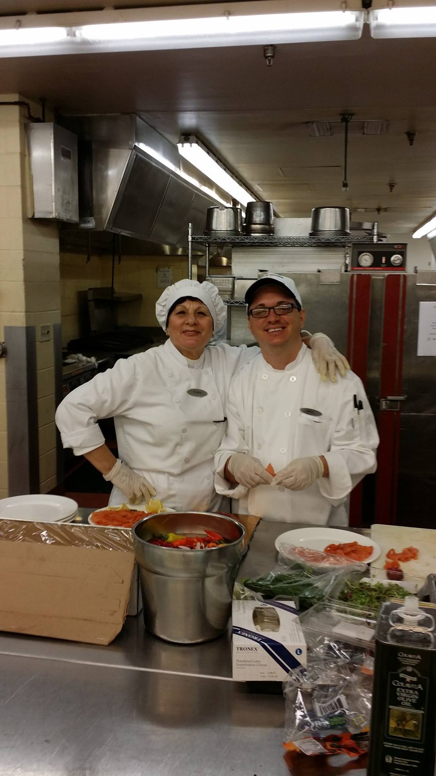
Hands On success Story Jimmy Offered Permanent Full-Time Position Hyatt Regency Jacksonville

Slide 22
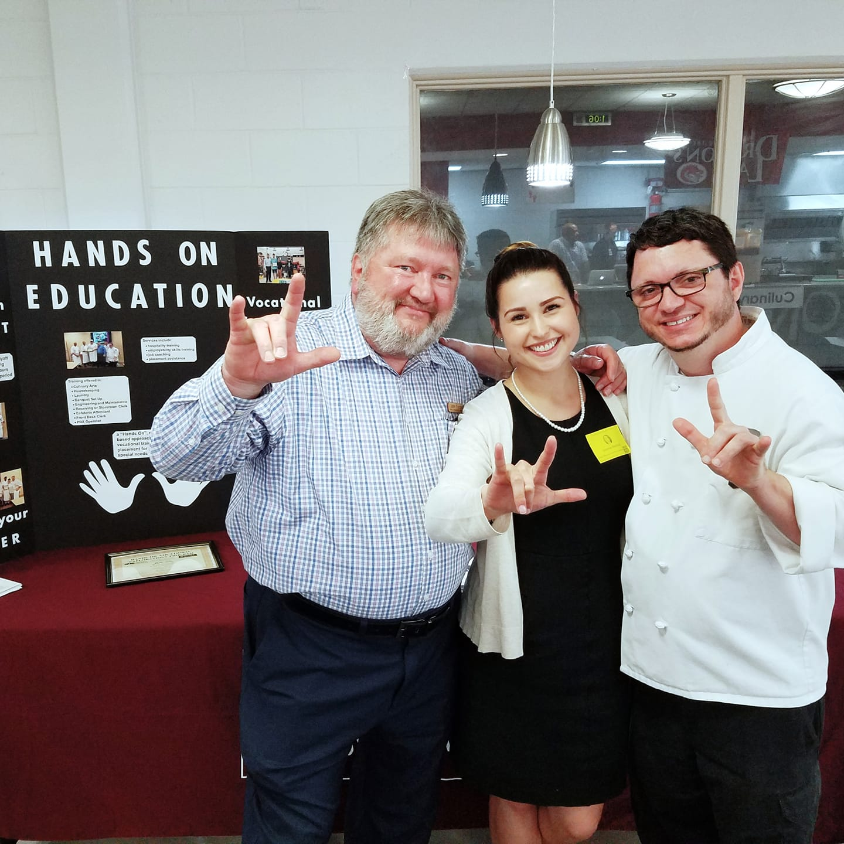
Hands On success Story Jimmy Graduated 2014 Hyatt Regency Jacksonville Continues to Work at HRJ And assists with Presentations and students who are Deaf
https://www.youtube.com/watch?v=SFu8xXVgWM4

Slide 23
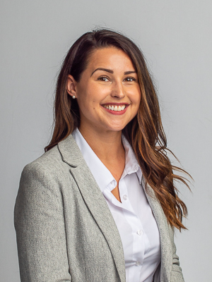
Leanne Rexford Director of Partner Relations The Able Trust
Leanne is a UCF Graduate and has worked in and around the hospitality industry for over 20 years. At Hyatt, she was the primary point of contact for Hands On Education and Vocational Rehabilitation. As an individual with a disability, Leanne understands the value of alternative vocational training programs and the need to include PWDs in all initiatives associated with Diversity, Equity and Inclusion.

Slide 24
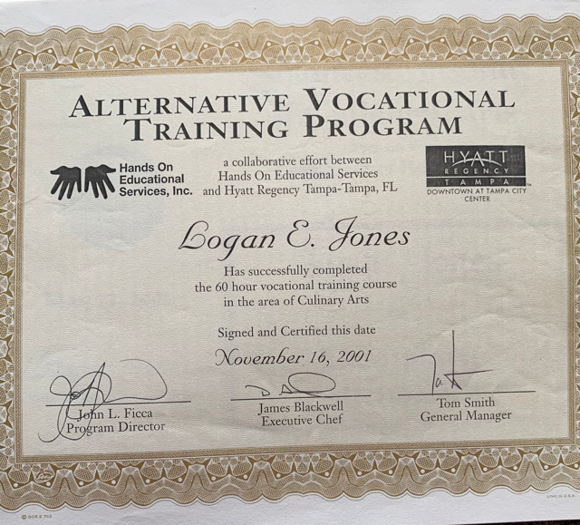

Slide 25
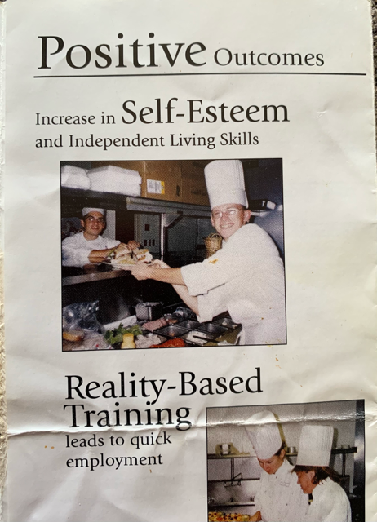

Slide 26
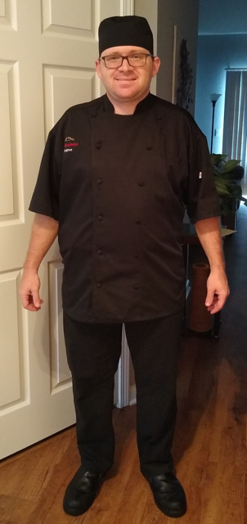
Logan Jones, Sous Chef
Magnolia Greens Golf Club - Leland, NC

Slide 27
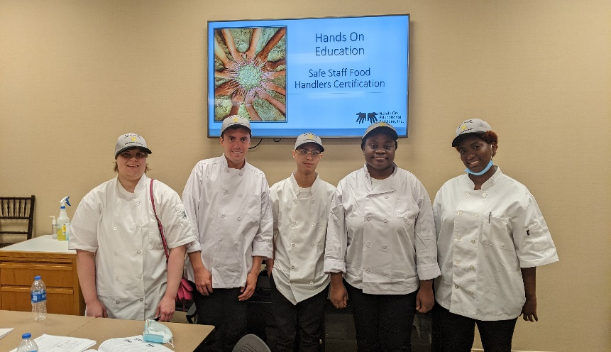
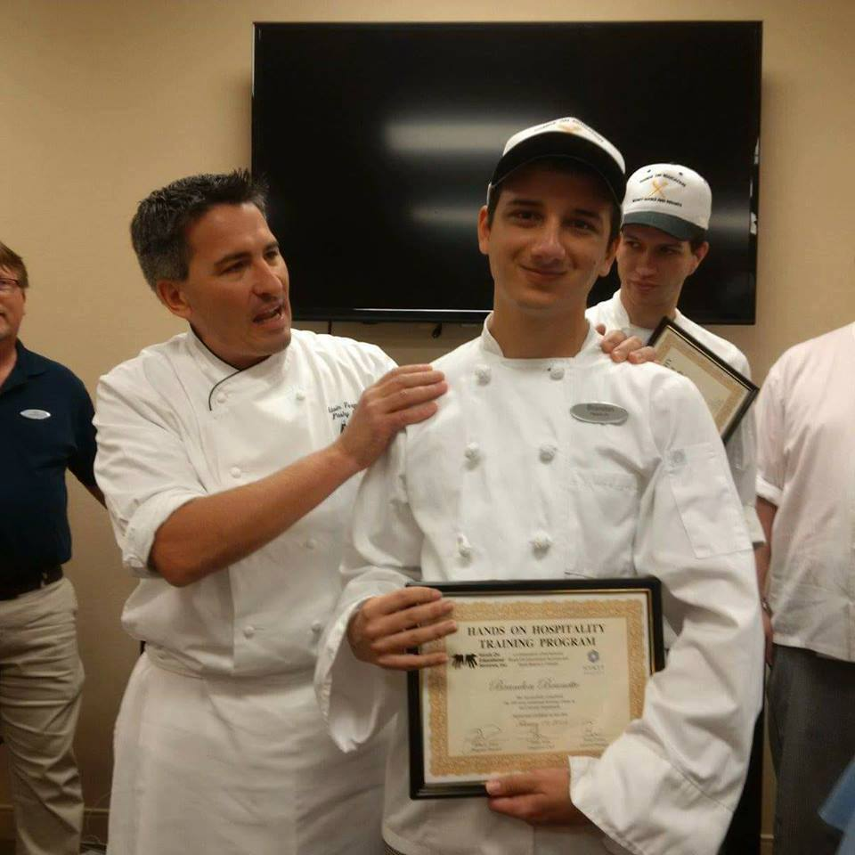
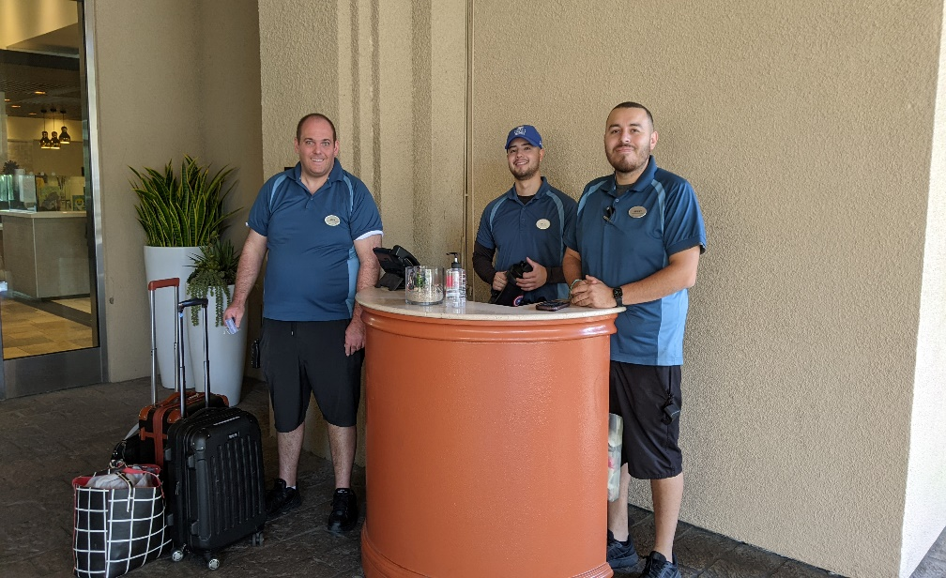
A full-feature film inspired by true events and the public / private partnership that continues to change the lives
of individuals with disABILITIES

Slide 28
Hands On @Hyatt 25th Anniversary Dinner
Friday August 25, 2023
Hosted by Hyatt Regency Grand Cypress (Orlando)
Food served by Hands On @Hyatt Students
Attended by Students, Families, ESE Teachers, VR Counselors and Hyatt Managers / Associates
Email John@handsoneducation.net
for more information

Slide 29
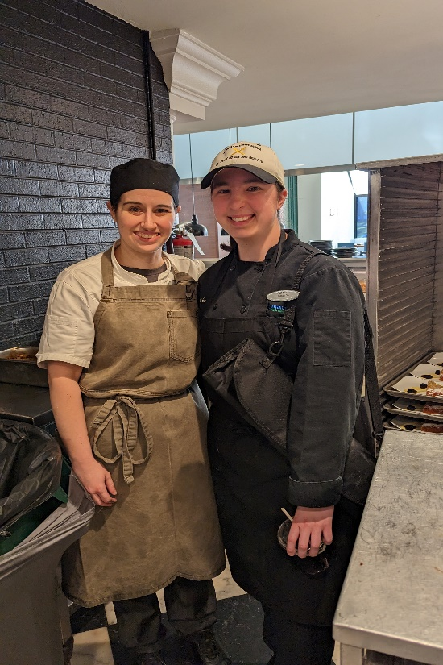
Accentuating the “I” in IEPs and IPEs

